Slide 1

DriverPass System Analysis
Alex McCool
Notes:
[No speaker notes required for this slide.]

Slide 2

System Requirements
Requirements
Customer Registration/Lesson Scheduling via Phone
Computer based learning for driving lessons
Non-functional Requirements
Web-based user interface
Username/password authentication system
Notes:
This system is to help customers use practice tests to prepare for a driver’s test. The other major feature is to schedule a physical driving lesson for the customer with a driver instructor.
The system is web based and includes a secure username/password authentication system.

Slide 3
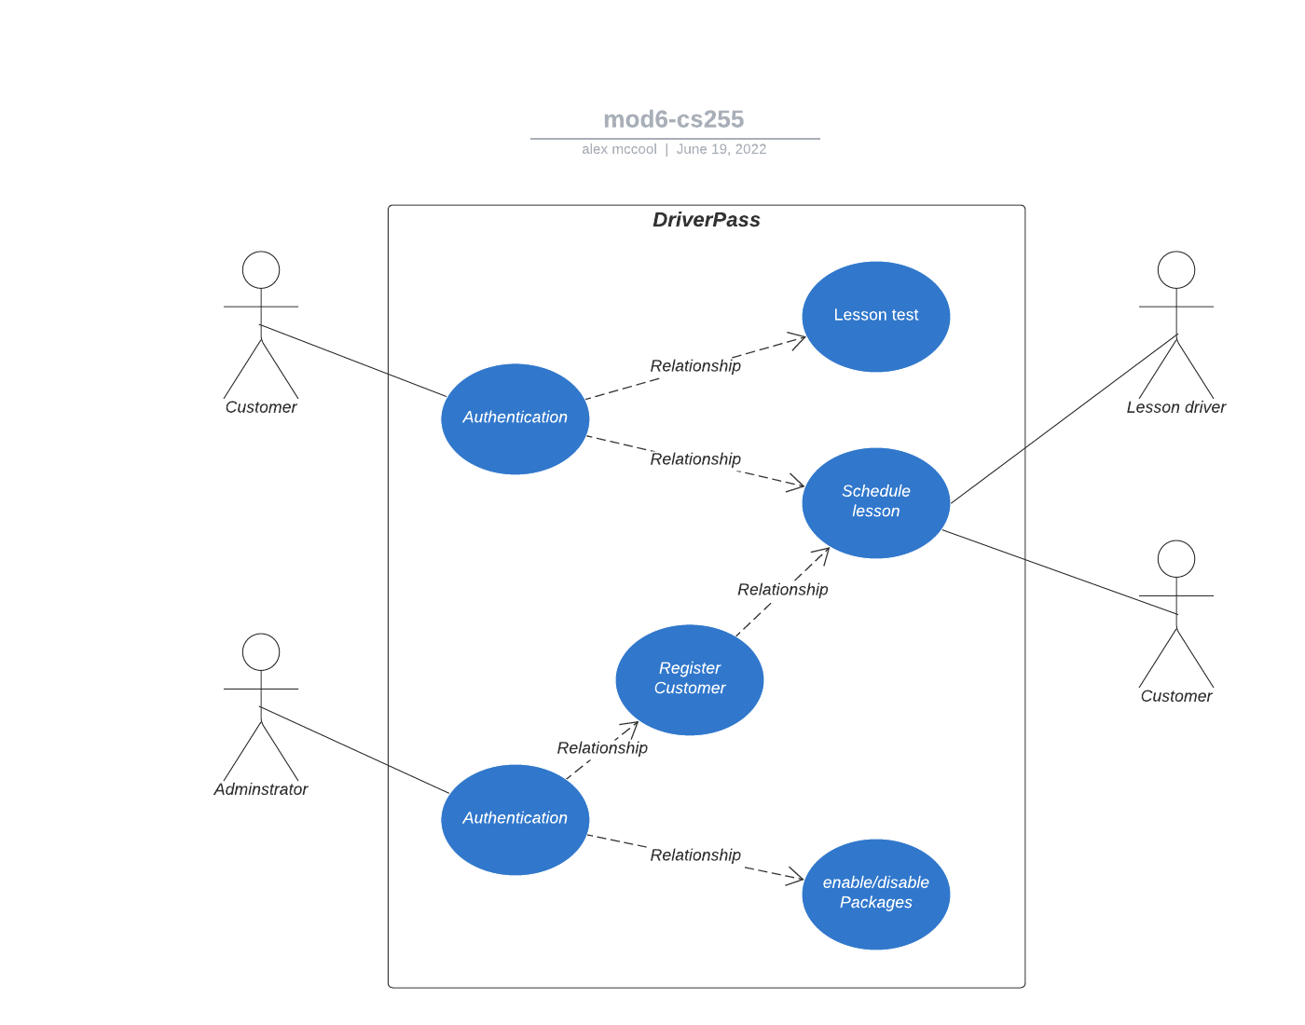
Use Case Diagram
Notes:
There are three participants in the system: Customers/Students, Administrators, and Driving Instructors. Customers use Computer based learning to practice for the written tests. Customer Schedule lessons on their own. Customers can call in and have Administrators schedule lessons for them. Administrators can enable/disable different available lesson packages.

Slide 4
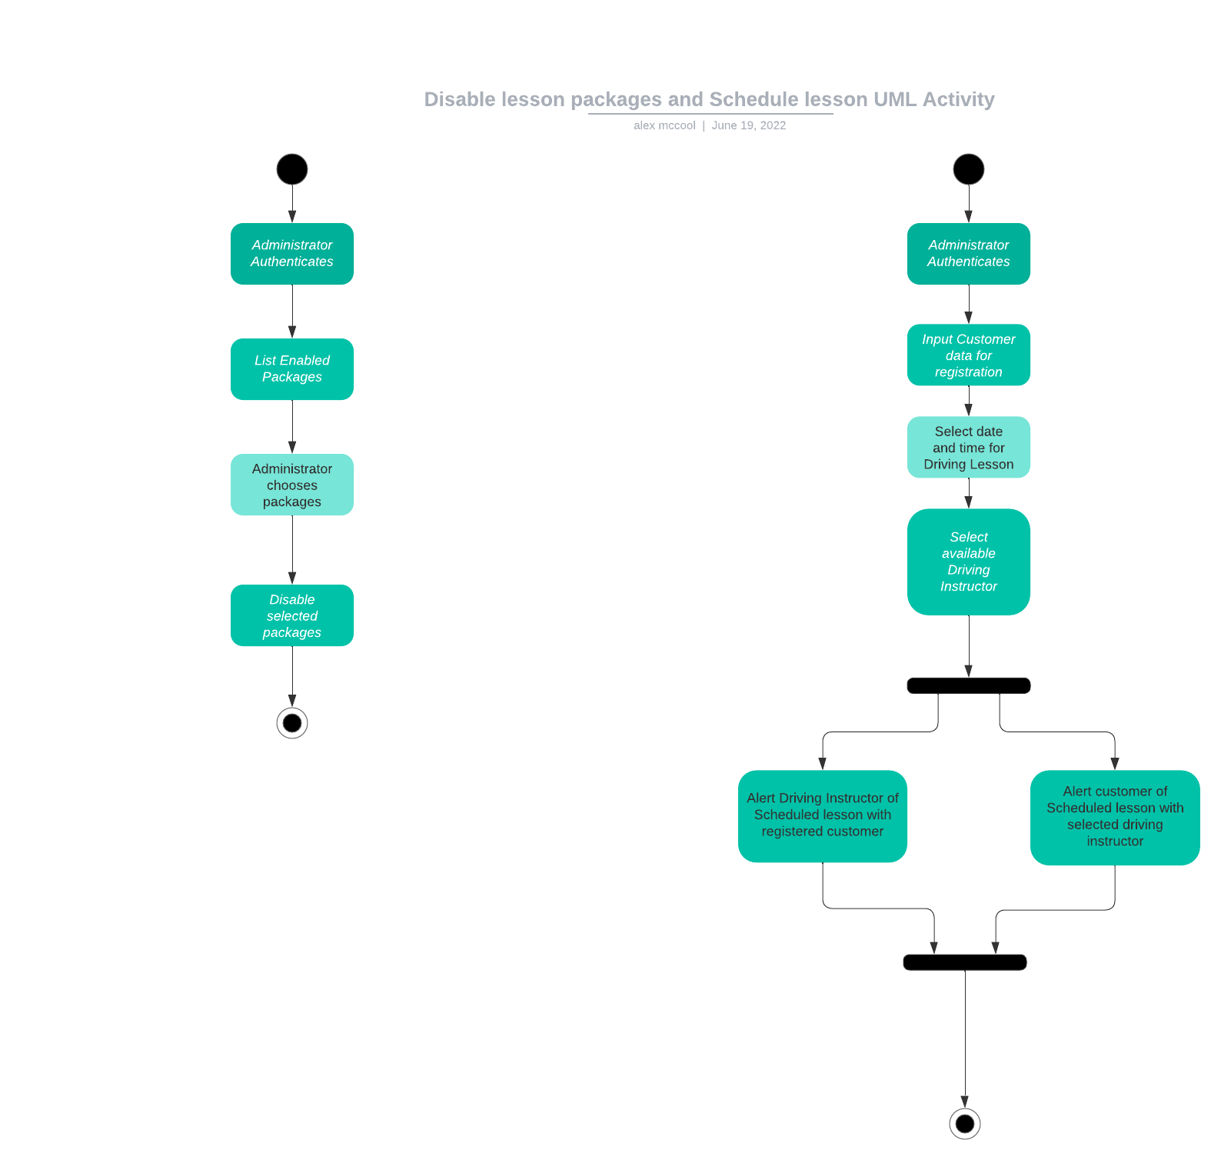
Activity Diagram
Notes:
Two activities are depicted. The first is how an administrator will login in and disable unwanted lesson packages. The second is the process followed for a administrator to register a customer, and schedule a lesson for them over the phone.
Disabling lesson packages is straight forward. Login the administrator, display a list of active lesson packages, let the administrator select the packages they want to disable, and then diable them.
The assisted registration of the customer entails the administration logging in, creating the customer record, inputting the lesson datetime, selecting an available driving instructor, then sending out a notification to both the driving instructor and the customer.

Slide 5
Security
All user activity is authenticated
Users are identified by their role
Audit trails are created for all activities
Notes:
To perform an activity the user must be authenticated.
Roles are established to prevent authorized access.
Audit trails are used to review system activity and confirm if there is any unauthorized access.

Slide 6
System Limitations
single server infrastructure design
Split the application ode and database servers in the future.
Future state: Load balancer will be required
Notifications are email
Change AlertManager in the future
Username/password authentication system
Change to OpenIdConnect to add additional identity providers.
Notes:
The system initially deployed in a limited capacity to keep costs down.
Future state is satisfied by splitting the components to move to additional servers.
Alert manager will need additional configuration to provider different alerting mechanisms.
Username/password is complex. Remove it in the future and replace with OpenIdConnect to utilize different identity providers.

